Slide 1
Getting Started with Java
Chapter 1
Sun Certified Java Programmer Workshop

Slide 2
Contents
Setting the scene
Installing and using Java SE
JAR files
Using an IDE
  Demo folder: DemoGettingStarted

Slide 3
1. Setting the Scene
Hello Java
Java timeline
Java vs. other languages
What can you do with Java SE?
What can you do with Java EE?

Slide 4
Hello Java
Java is one of the most widely-used object-oriented languages in contemporary software development
  Other popular OO languages include C#, C++, etc.
OO principles:
  Abstraction
  Encapsulation
  Inheritance
  Polymorphism

Slide 5
Java Timeline
Java first appeared in 1996
  Java Development Kit (JDK) 1.0
  Contained 6 packages
  Original goal was to create platform-agnostic apps for mobile devices
  In practice, many organizations used Java to create applets
Sun reorganized their Java products in 1999
  Java 2 Standard Edition (J2SE)
  Java 2 Enterprise Edition (J2EE)
  Java 2 Micro Edition (J2ME)
There have been many subsequent upgrades to the language and libraries
  We're using Java 2 Standard Edition, version 1.6

Slide 6
Java vs. Other Languages
Java vs. C++
  Java syntax is very similar to C++ (not coincidental)
  Java compiles to platform-neutral byte codes that run on a Java Virtual Machine (JVM), whereas C++ compiles to platform-specific machine instructions
  Java handles memory management via garbage collection, whereas C++ makes you manage memory yourself
  Java has an extensive and rich class library, whereas the C++ standard class library is much more limited
  Java doesn't run as quickly (or as leanly) as C++
Java vs. C#
  Java syntax is very similar to C# (again, this is no coincidence!)
  In fact, Java and C# are quite comparable in many aspects…

Slide 7
What can you do with Java SE?
You can use Java SE to:
  Create standalone Java applications
  Create Windows-based applications
  Manipulate text files, binary files, and XML data
  Access databases, via Java Database Connectivity (JDBC)
  Create multithreaded applications
  Create client-server applications, using Remote Method Invocation (RMI)

Slide 8
What can you do with Java EE?
Going further, you can use Java EE to create:
  Web applications, using servlets and JavaServer Pages (JSPs)
  Web services
  Middle-tier session beans, using Enterprise JavaBeans (EJBs)
  Data-access entity beans, using the Java Persistence API (JPA)
  Message-queueing applications, using the Java Message Service (JMS)

Slide 9
2. Installing and Using Java SE
Downloading Java SE
Installing Java SE
Java SE folder structure
Minimalistic development

Slide 10
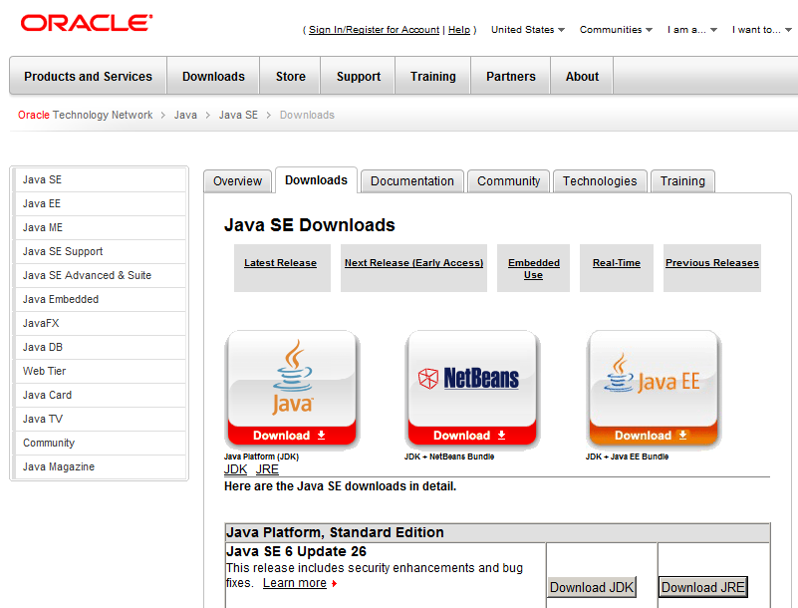
Downloading Java SE
Download Java Standard Edition from:
  http://www.oracle.com/technetwork
  /java/javase/downloads/index.html
Download the JDK
(Java Development Kit)

Slide 11
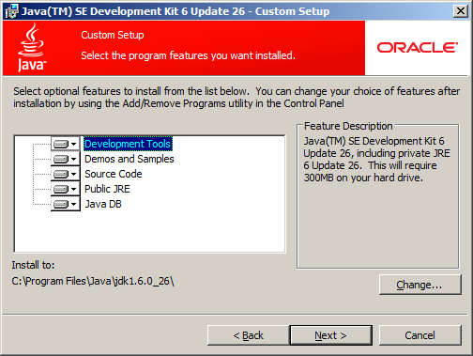
Installing Java SE
Run jdk-6uXX-windows-i586.exe
  Accept all defaults

Slide 12

Java SE Folder Structure
Default installation folder for Java SE (v1.6, update XX):
  C:\Program Files\Java\jdk1.6.0_XX
Folder structure:
JDK tools (compiler, etc)
Java Runtime Environment (JVM, etc)
Additional libraries for development

Slide 13
Minimalistic Development (1 of 2)
Define a public Java class
  Filename must be classname.java
Compile the class from the command line
  Using the Java compiler, javac.exe
  Note, javac.exe must be on the path
  Also, the classes that you use must be on the "classpath"
public class MyFirstApp {
public static void main(String[] args) {
System.out.println("Hello world");
}
}
MyFirstApp.java
C:\> javac MyFirstApp.java
Creates MyFirstApp.class

Slide 14
Minimalistic Development (2 of 2)
Run the class from the command line
  Via the JVM, java.exe
  Note, java.exe must be on the path
  Also, the classes that you use must be on the "classpath"
C:\> java MyFirstApp
Hello world
Note, you specify the classname
without the .class file extension

Slide 15
3. JAR Files
Overview of JAR files
How to create a JAR file
Example
How to run a JAR'd application

Slide 16
Overview of JAR Files
In a real Java application, you'll have lots of Java classes
  Each class is compiled to a separate .class file
It's common to bundle up all the classes etc. into a JAR file
  Typically use the .jar file extension
  The Java Archive (JAR) file format is a zip-file really
You can manage JAR files by using the jar.exe tool from the command line
  Part of the JDK ☺

Slide 17
How to Create a JAR File
To create a JAR file:
Here's a description of the options:
  c means you want to create a JAR file
  f means you want the output to go to a file (rather than STDOUT)
  m means you want to include a manifest file (see later)
And here's a description of the file names:
  jar-file-name is the name of the JAR file you want to create
  manifest-file-name is the name of the manifest file (see later)
  input-file(s) is a list of files to include in the JAR file
C:\> jar cfm jar-file-name manifest-file-name input-file(s)

Slide 18
Example: Java Files
Let's see how to create a JAR file containing 2 Java classes
  See the DemoGettingStarted folder
Here's the "main" Java class for the application:
And here's a "helper" Java class for the application:
public class MyProg {
public static void main(String[] args) {
System.out.println("Hello from my program.");
MyHelper.displayDateTime();
System.out.println("Goodbye from my program.");
}
}
MyProg.java
public class MyHelper {
public static void displayDateTime() {
System.out.println("It is now " + new java.util.Date());
}
}
MyHelper.java

Slide 19
Example: Specifying the Entry Point
If you have an application bundled in a JAR file, you need some way to indicate which class file is the entry point
  You provide this information in a "manifest file"
  Set the Main-Class property to the name of the main class
Notes:
  You must specify the fully-qualified name of the class (including its package name - see later for more info about packages)
  The manifest file must end in a new line or carriage return
Main-Class: MyProg
Manifest.txt

Slide 20
Example: Creating the JAR File
First, compile the Java classes:
Then create a JAR file containing the .class files and the manifest file
C:\> javac MyProg.java MyHelper.java
C:\> jar cfm MyFirstJarFile.jar manifest.txt MyProg.class MyHelper.class

Slide 21
How to Run a JAR'd Application
To run a JAR'd application:
  Run java.exe to launch the Java Virtual Machine
  Use the -jar option to indicate you want to run a JAR file
  The JVM consults the manifest file to determine the main class
C:\> java -jar MyFirstJarFile.jar
Hello from my program.
It is now Fri Jun 17 10:54:07 BST 2011
Goodbye from my program.

Slide 22
4. Using an IDE
Benefits of using an IDE
Popular Java IDEs
Downloading and installing Eclipse
Starting Eclipse
Creating a project
Adding a class
Implementing the class
Running the class

Slide 23
Benefits of Using an IDE
In practice, all Java developers use an IDE (rather than a text editor and the command line!)
  Improves productivity
  Simplifies compile/run cycle
  Offers IntelliSense
  Provides code refactoring capabilities
  Simplifies library management

Slide 24
Popular Java IDEs
Popular Java IDEs:
  Eclipse (we'll be using this)
  Oracle JDeveloper
  IBM WebSphere Application Developer
  Sun NetBeans
  Etc…

Slide 25
Downloading and Installing Eclipse
In a browser window:
  Browse to http://www.eclipse.org/downloads
  Click the Eclipse IDE for Java Developers product
In the next Web page:
  Download eclipse-java-galileo-SR2-win32.zip from one of the mirror sites
Unzip eclipse-java-galileo-SR2-win32.zip
  To the C:\ destination folder
  Creates a folder named C:\eclipse

Slide 26
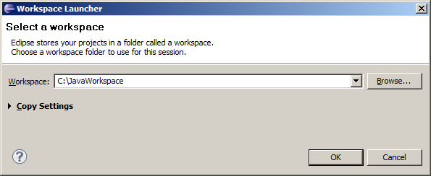
Starting Eclipse
Start Eclipse
  i.e. run c:\eclipse\eclipse.exe
Eclipse prompts you for a workspace
  The workspace is a folder that will contain all your Java projects
  Specify C:\JavaWorkspace

Slide 27
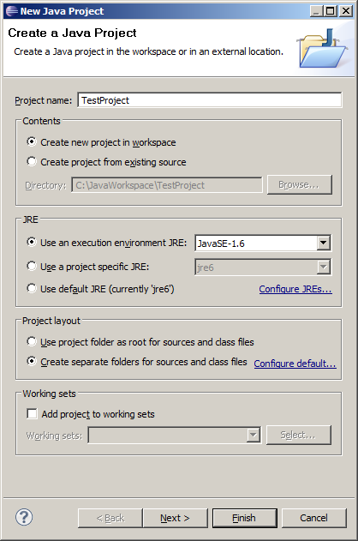
Creating a Project
Create a new Java project
  Via File | New | Java Project
  Specify a meaningful project name,
  e.g. TestProject
  Accept default options

Slide 28
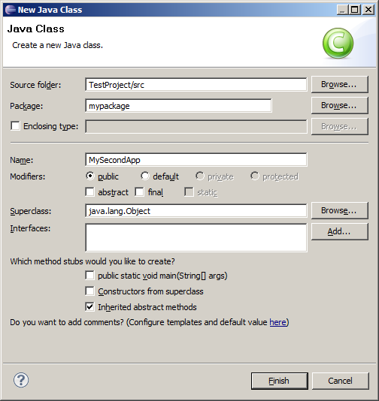
Adding a Class
In the src folder, add a class
  Preferably in a named package
  (A package is a group of related classes)

Slide 29
Implementing the Class
Implement the class, e.g:
package mypackage;
public class MySecondApp {
public static void main(String[] args) {
System.out.println("Eclipse says Hello!");
}
}
MySecondApp.java

Slide 30

Running the Class
To run the class using Eclipse:
  Right-click in Code Editor window, and click Run As | Java Application
  (Eclipse has access to JDK and classpath)
  Displays output in Console window

Slide 31
Summary
Setting the scene
Installing and using Java SE
JAR files
Using an IDE

